Slide 1
INTERNIXA
An AI-Monitored E-Learning Ecosystem with
Real-time Engagement Intelligence and Generative AI Assistance
By: [STUDENT NAMES]
Guide: [GUIDE NAME]

Slide 2
Introduction: Background
Growth of E-Learning: Global shift to digital education post-pandemic.
Passive Learning Crisis: Students often play videos without active attention.
Monitoring Gap: Existing platforms lack a way to verify student presence.
Academic Friction: Need for digital mentorship and accountability.

Slide 3
Problem Statement
Lack of Accountability: Purely watch-time based certifications are unreliable.
AI Hallucinations: Generic chatbots provide irrelevant academic help.
Low Engagement: Passive content consumption leads to high dropout rates.
No Real-time Feedback: Instructors cannot monitor student focus in live meets.

Slide 4
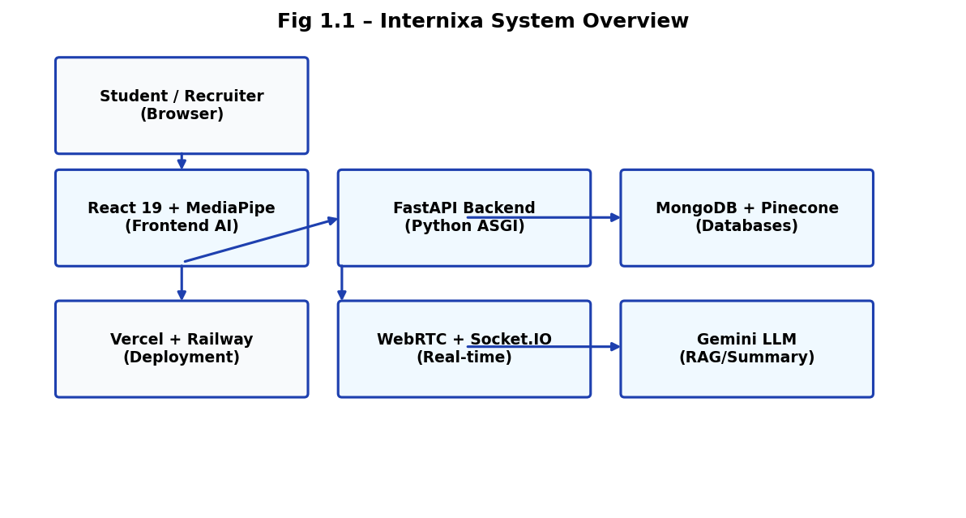
Project Objectives
Implement real-time AI attention monitoring (<100ms latency).
Develop intelligent video pause/resume based on EAR & Gaze.
Build a context-locked RAG Chatbot grounded in course transcripts.
Generate engagement-gated certifications (threshold: 75%).
Create a gamified learning environment with Focus Points (FP).

Slide 5
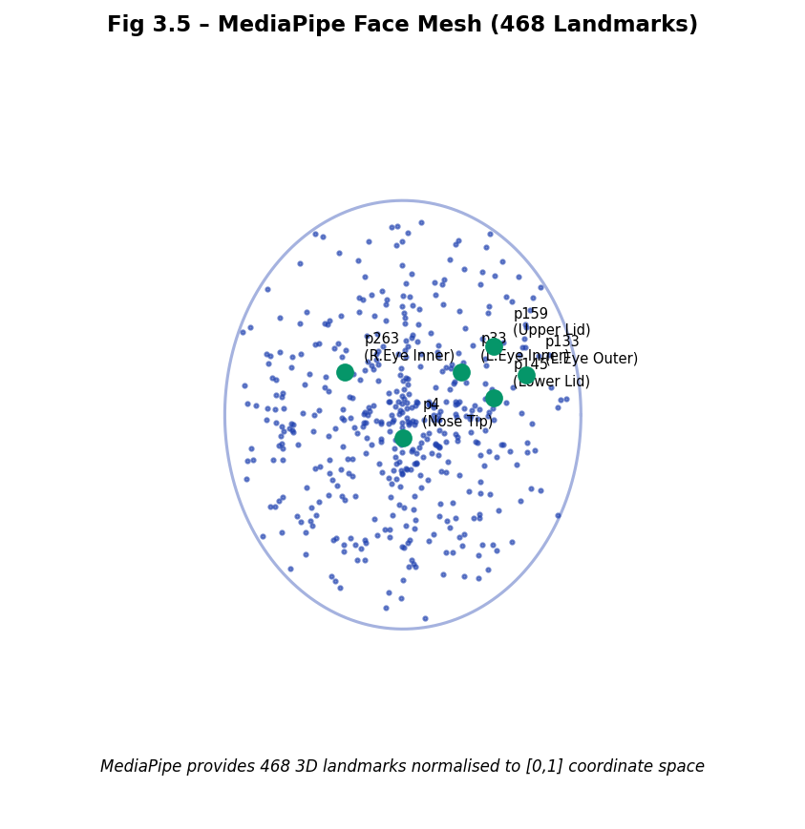
Literature Review (AI Vision)
MediaPipe Face Mesh (Google): 468 3D landmarks for real-time tracking.
Eye Aspect Ratio (Soukupova & Cech): Euclidean distance for blink detection.
Head Pose Estimation: Used for calculating gaze deviation and distraction.

Slide 6
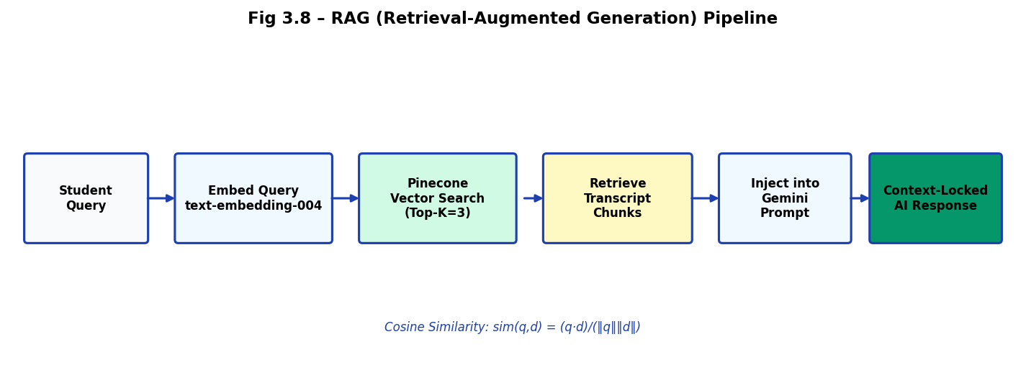
Literature Review (AI & Web)
RAG Pipeline (Lewis et al.): Grounding LLMs in external knowledge stores.
WebRTC (W3C): Peer-to-peer real-time communication for browser meetings.
Gamification Theory: Points-Badges-Leaderboards (PBL) for motivation.

Slide 7
Comparative Analysis
Traditional LMS: Passive, no monitoring, generic AI, time-based certs.
INTERNIXA: Active vigilance, context-locked AI, focus-based certs.
Gamification: Real-time leaderboard vs. zero engagement tracking.

Slide 8
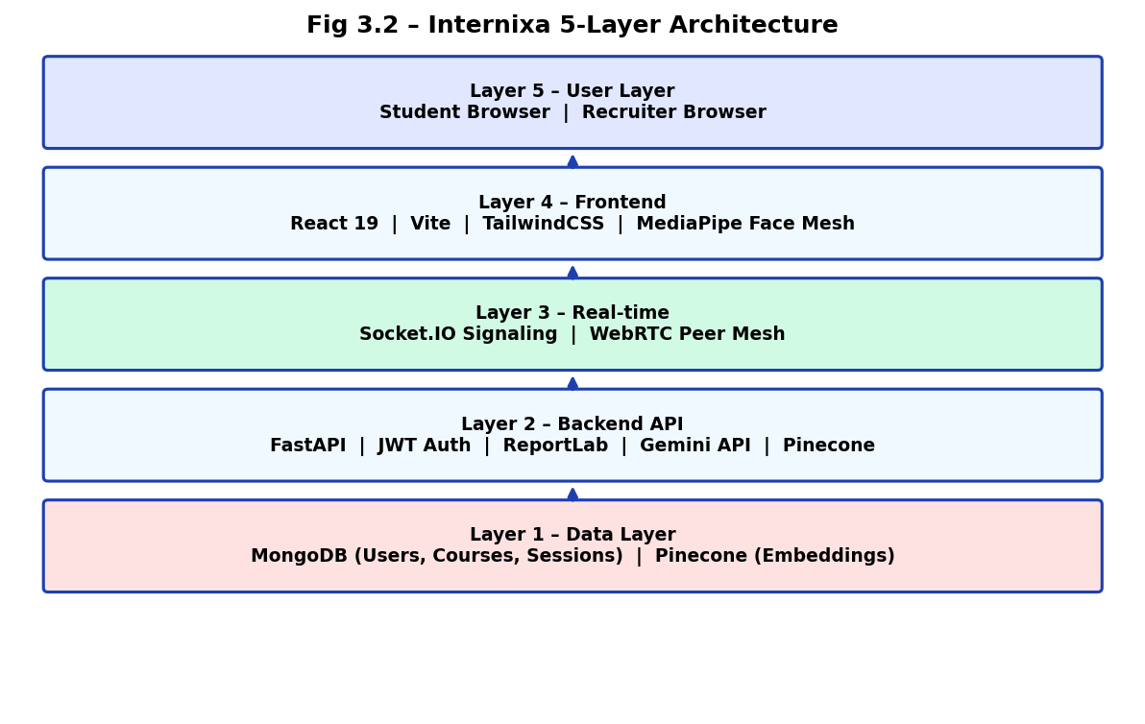
Proposed System Overview
Closed-loop Ecosystem: Connects vision, chat, and certification.
Edge AI Strategy: On-device processing for privacy and low latency.
Admin/Recruiter Portal: Direct talent scouting based on focus data.
Multi-persona support: Students, Instructors, and Recruiters.

Slide 9
System Architecture

Slide 10
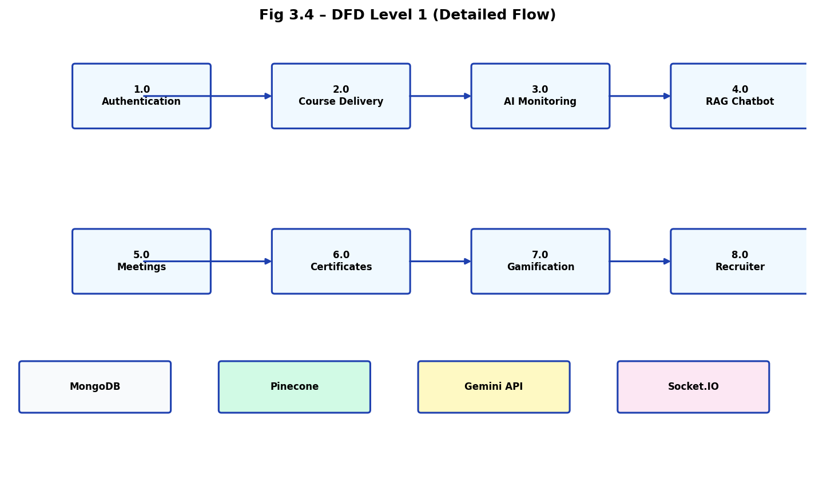
Functional Data Flow (DFD)

Slide 11
Methodology: AI Monitoring
Frame capture at 30 FPS.
MediaPipe Face Mesh landmark extraction.
Privacy: No video leaves the student's browser.
Hysteresis logic to prevent flickering during blinks.

Slide 12
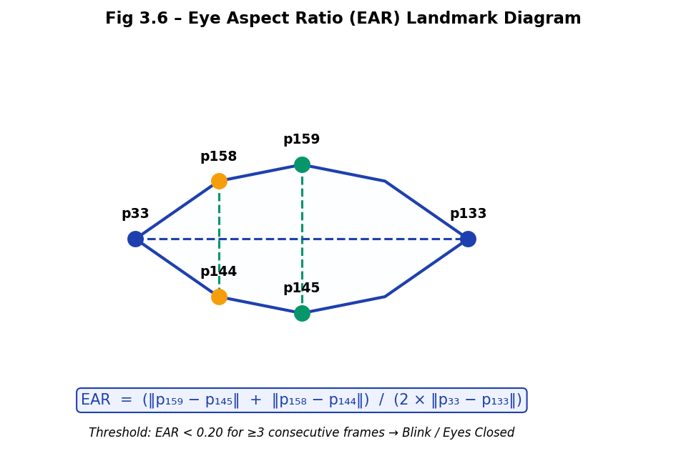
EAR & Gaze Detection
EAR Formula: Vertical vs. Horizontal eye ratios.
Blink Detection: EAR < 0.20 for 3 consecutive frames.
Gaze Deviation: Nose tip offset from eye midpoint.
Auto-pause triggered if deviation > 35% of eye width.

Slide 13
RAG Chatbot Pipeline
Transcript Chunking: 500-char segments with overlap.
Vectorization: Text-embedding-004 to Pinecone.
Retrieval: Top-3 chunks via Cosine Similarity.
Generation: Context-injected Gemini LLM response.

Slide 14
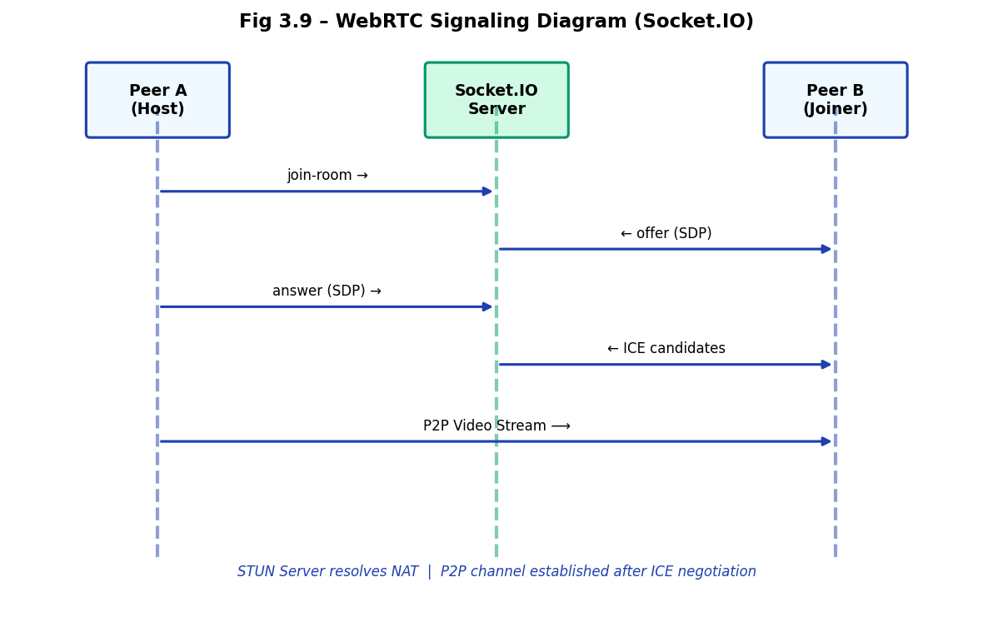
WebRTC & Live Signaling
Peer-to-Peer Architecture: RTCPeerConnection.
Signaling: Socket.IO for SDP and ICE exchange.
Host HUD: Real-time engagement alerts for all participants.
Anomaly detection: Detecting sleep/absent states.

Slide 15
Module Breakdown (Modules 1-4)
M1: AI Monitoring Engine (React/MediaPipe).
M2: Smart Course Player (State-sync with AI).
M3: RAG Chatbot (Pinecone/Gemini integration).
M4: Live WebRTC Meeting System (Socket.IO).

Slide 16
Module Breakdown (Modules 5-8)
M5: Gamification Engine (FP & Leaderboard).
M6: Certificate Generation (ReportLab PDF).
M7: Smart Study Sheets (AI Summaries).
M8: Recruiter Portal (Hiring & Scouting).

Slide 17
Implementation: Tech Stack
Frontend: React 19 + Vite + TailwindCSS.
Backend: FastAPI (Python) + Uvicorn.
Databases: MongoDB Atlas + Pinecone Vector DB.
AI: MediaPipe + Google Gemini 1.5 Flash.
Deployment: Vercel + Railway Cloud.

Slide 18
Performance Analysis
AI Inference: ~28ms per frame (Smooth 35 FPS).
API Response: <200ms average latency.
WebRTC Join: ~2.4s connection establishment.
Accuracy: >95% attention state detection accuracy.

Slide 19
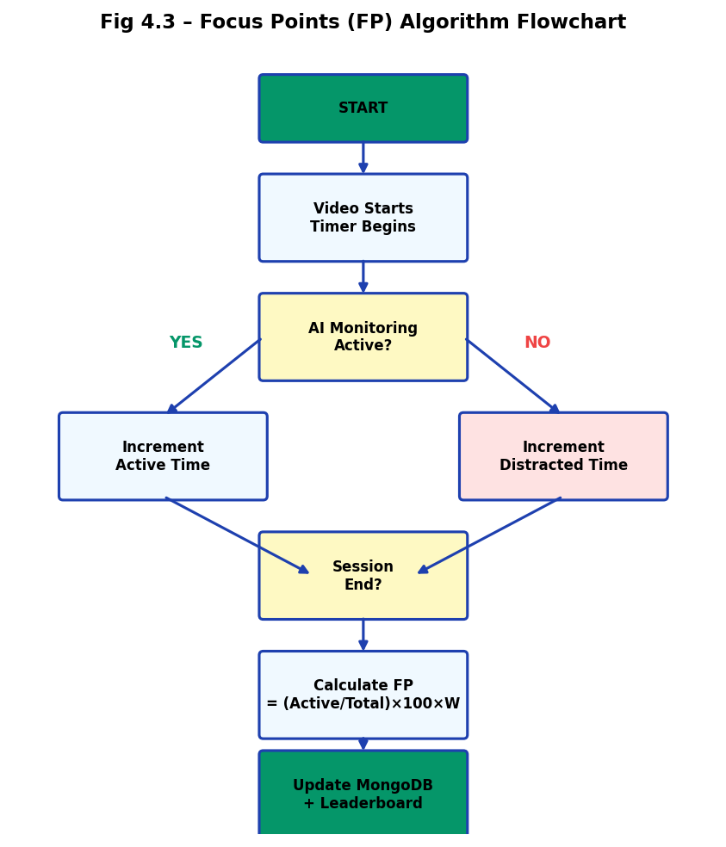
Results & Outcomes
Engagement Uplift: +38% focus rate vs. passive LMS.
Integrity: Certificates issued only for verified focus.
Gamification Impact: 87% weekly leaderboard engagement.
Recruiter Feedback: High value in 'Focus Score' metrics.

Slide 20
Conclusion & Future Scope
Summary: Successfully built a closed-loop AI learning system.
Multi-face Detection: Preventing proxy attendance.
Mobile Port: Bringing AI monitoring to Flutter/Mobile.
LMS Plugin: Integration with Moodle and Canvas.

